Slide 1
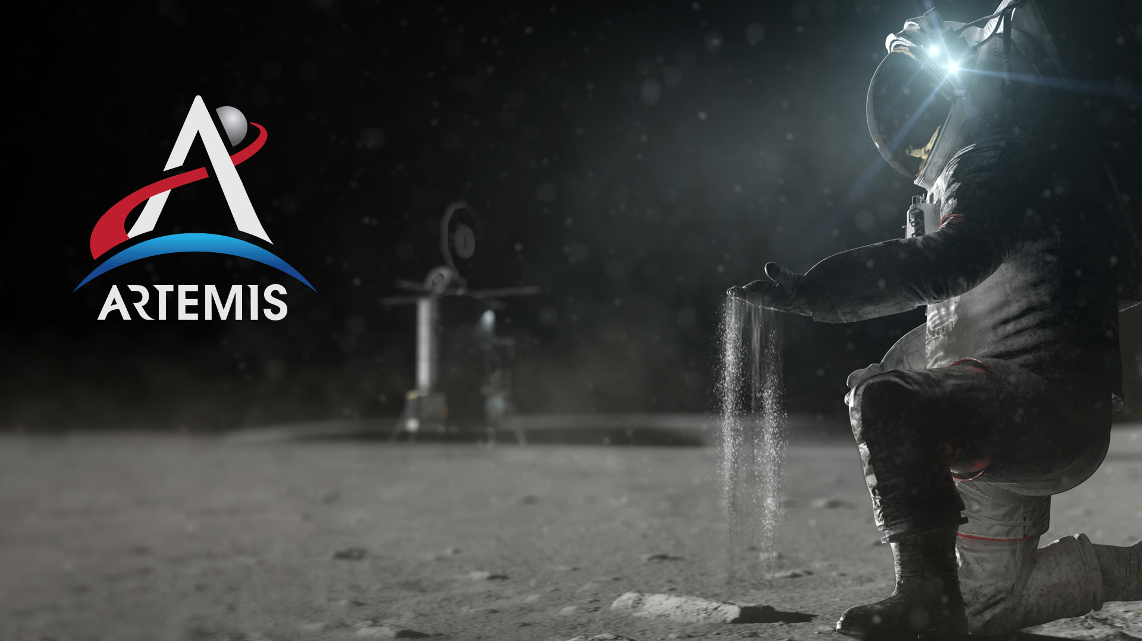
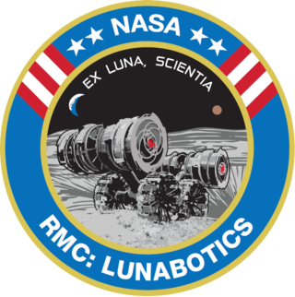
NASA Lunabotics
Regolith Mining Rover
Kinematics & Simulation for
EE 428 Robotics Fundamentals
Kevin Jordan

Slide 2
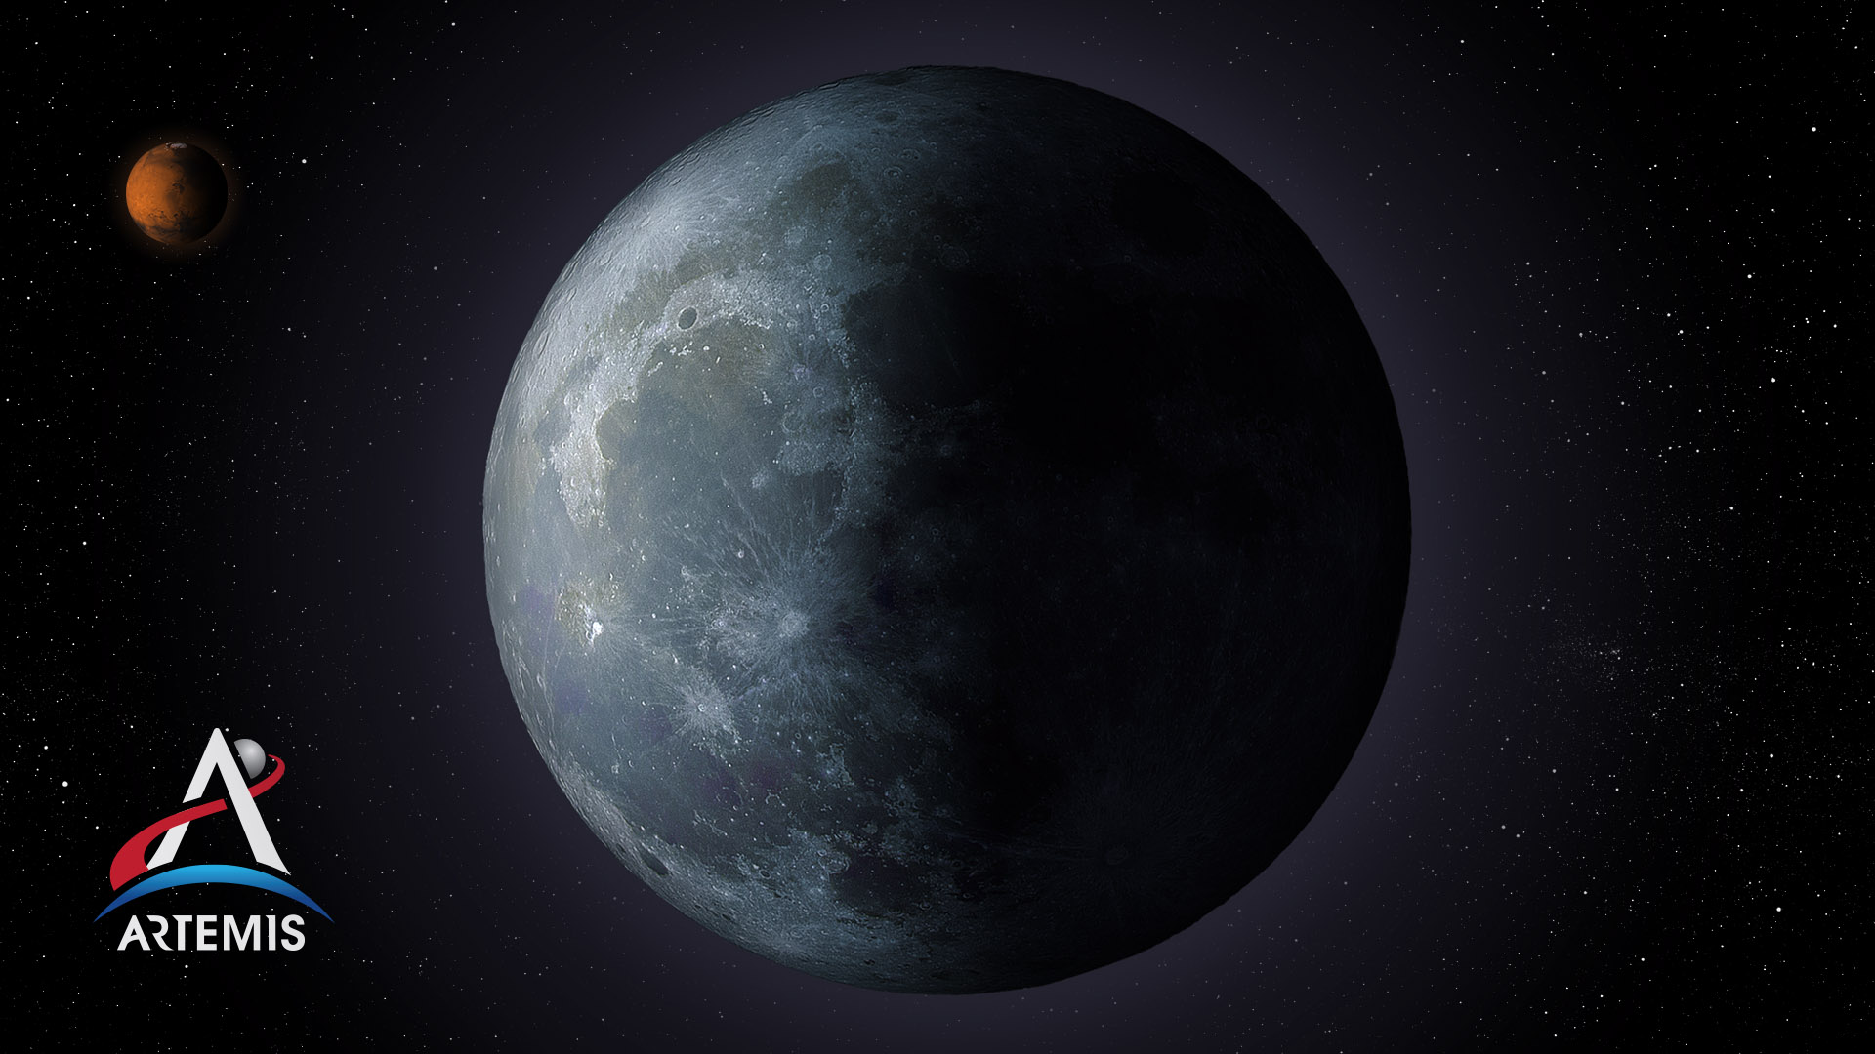
Presentation Overview
Background
Project Introduction
Mathematical Model
True Model
Simplified Model
Forward Kinematics
Inverse Kinematics
Simulation
ROS
URDF & other needed filetypes
rviz
Gazebo
Demo
Rover Integration & Testing (Future work)
Conclusions
References

Slide 3
I. Background
NASA Lunabotics Competition:
Multi-University engineering competition
Design and build a regolith mining robot within NASA specified constraints
Public outreach and activities to grow STEM interest in pre-college youth
Acting role as EE/CS Team Lead

Slide 4
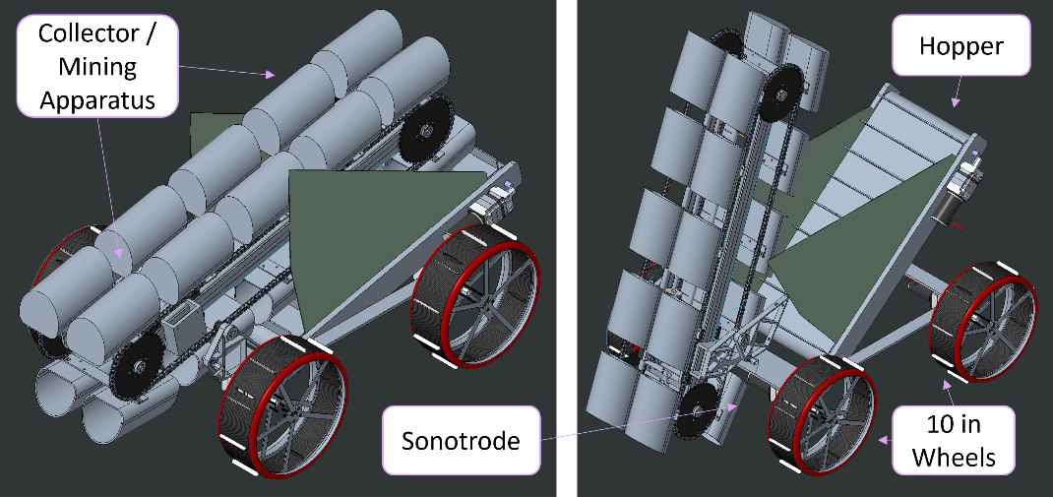
II. Project Introduction
5 Phase project:
I-III: Scoping, Research, & Hardware Design == 1st Semester
IV-V: Building & Debugging == 2nd Semester
As rover will be build next term, EE 428 == simulation only project
Simulation will allow algorithm / software development while waiting for integration – complex computer vision and full autonomous operation

Slide 5
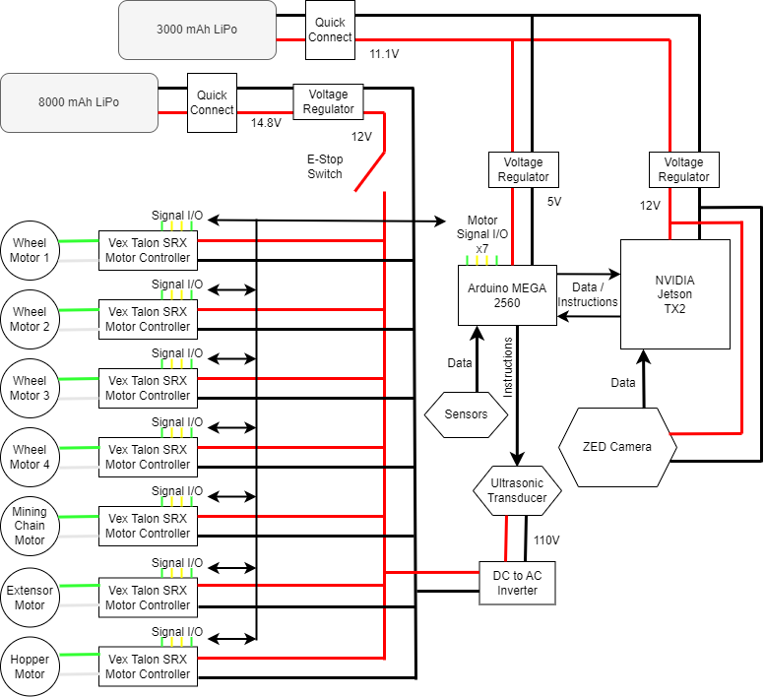
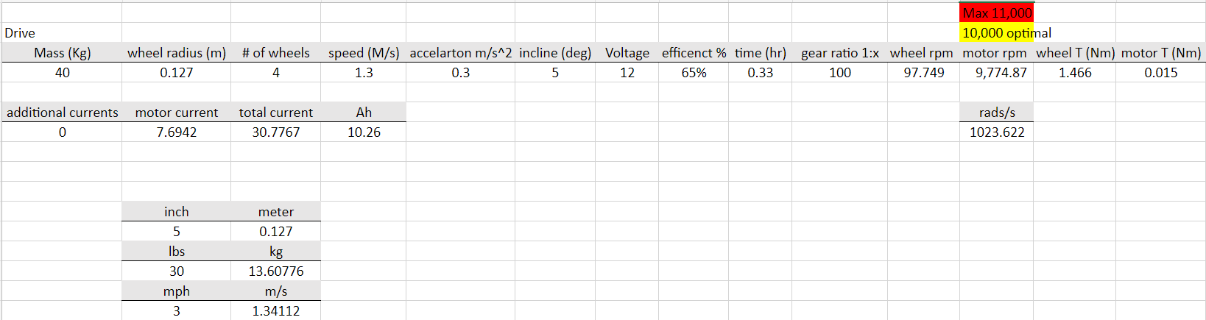
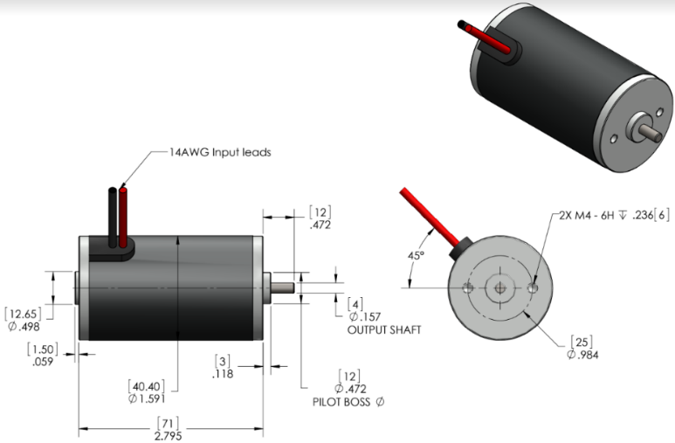
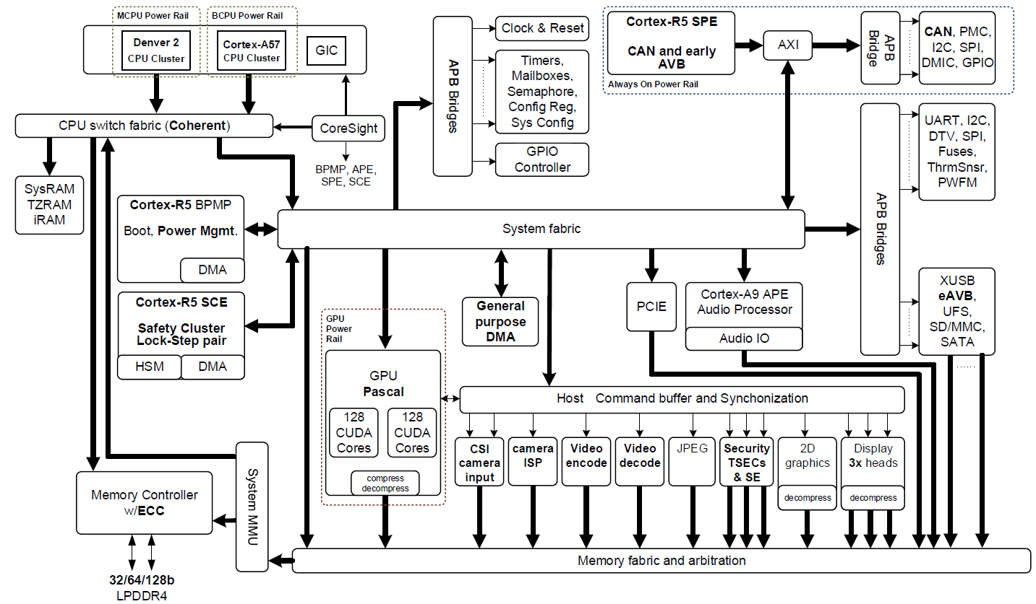
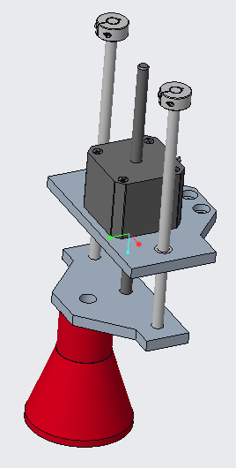
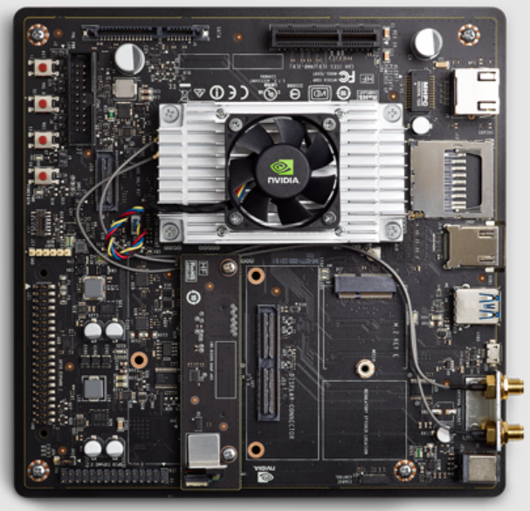
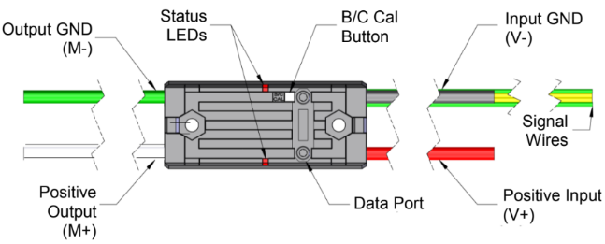
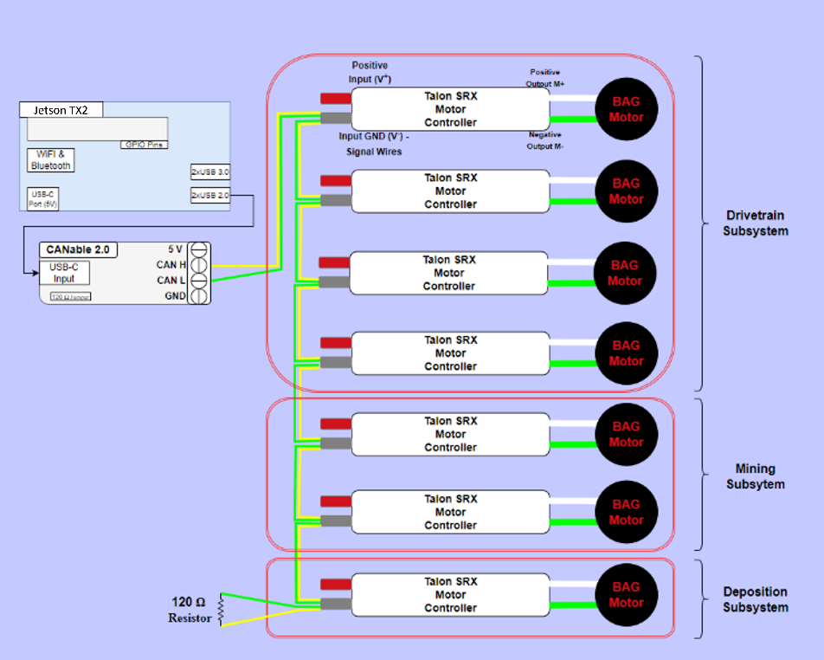
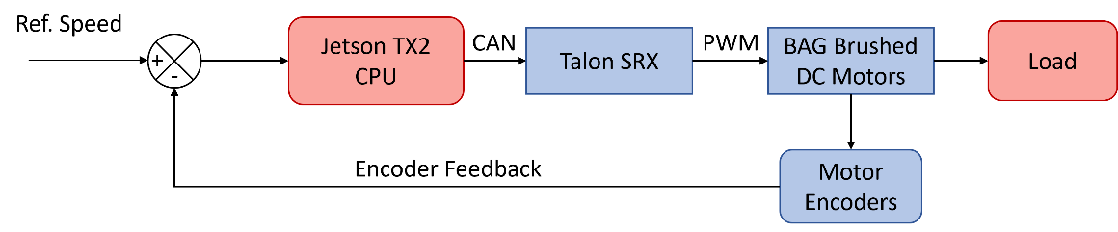
II. Project Introduction
Hardware

Slide 6
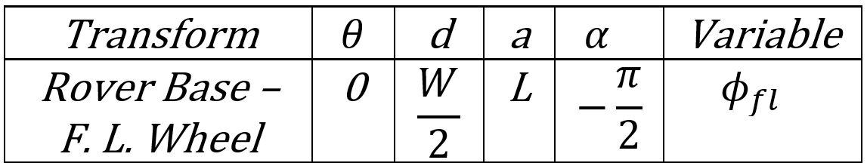
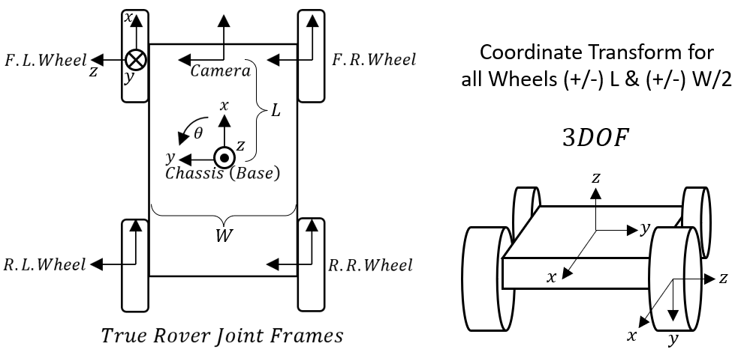
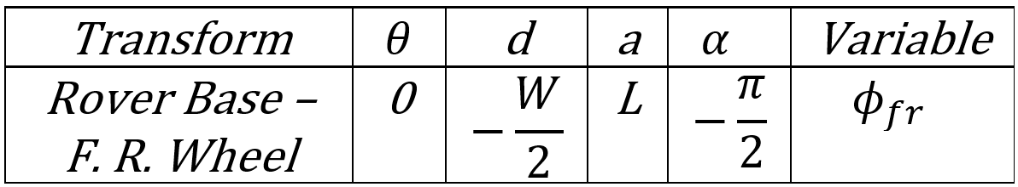
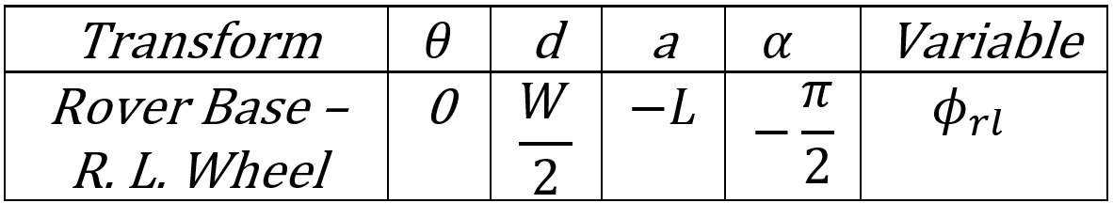
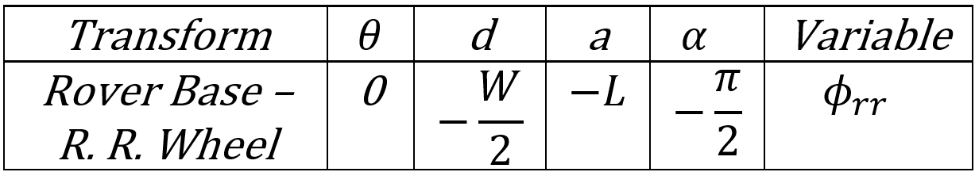
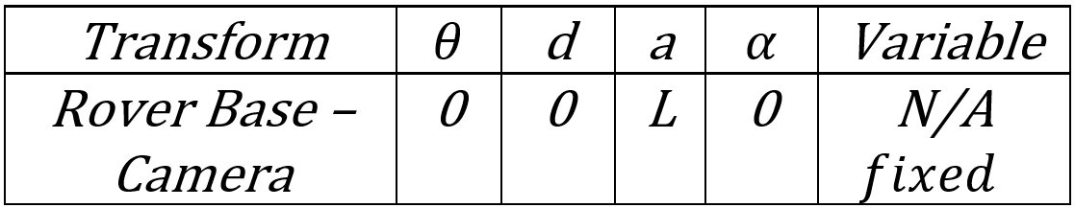
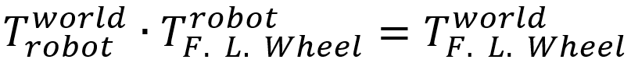
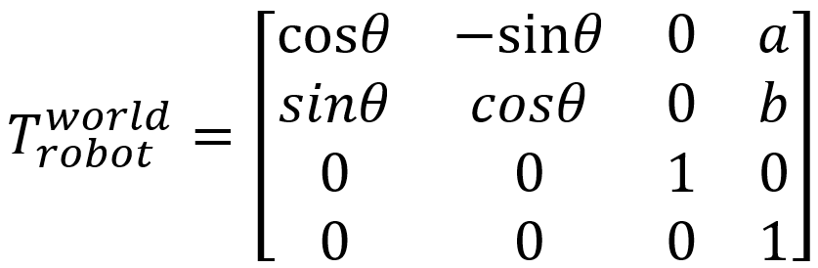
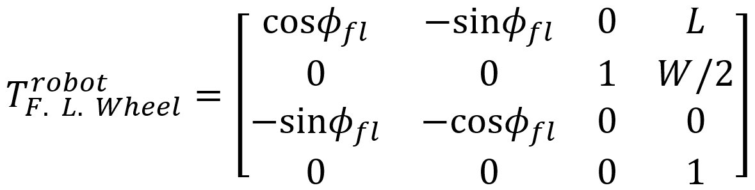
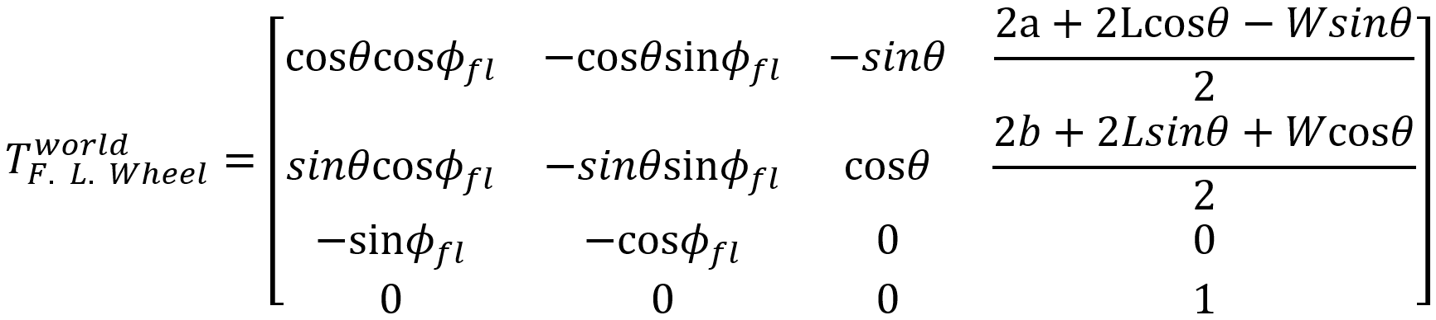
III. Mathematical Model
Difficulties, Limitations, & Considerations
DH convention
Only 1 joint in chain so DH Table overkill
World to wheel frame includes x, y, & z so no direct DH from world to wheel frame
Homogeneous Transform makes more sense
Non-holonomic
No direct lateral translation possible
Only achieved by combo of Rot,z & Trans,x
Simulation target hardware limitations
ROS requires specific Linux distro
My more powerful / recent machine (16GB Ram / 4-core i7) has RAID enabled for SATA so failed to install Ubuntu 20.04 dual boot or VM
a. True Model
D.H. Tables
Ran simulation on old machine (4GB RAM / 2-core m3 as VM
Full model simulation just was not able to run on available machine

Slide 7
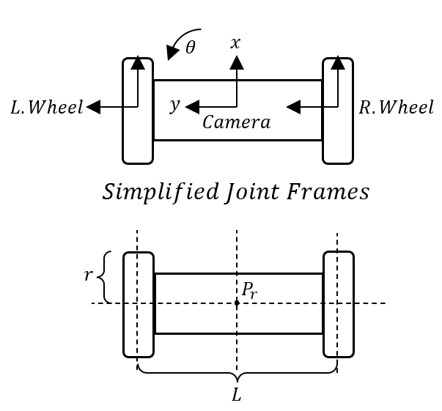
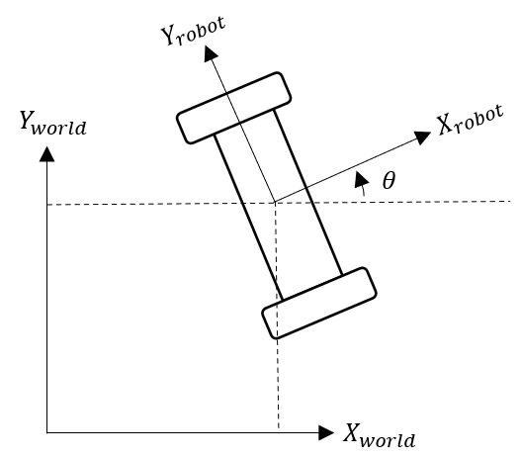
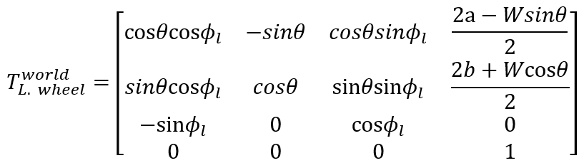
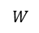
III. Mathematical Model
b. Simplified Model
Differential Drive 2-Wheeled Mobile Robot
Put robot center fixed joint in camera position
Also center of axis of rotation for wheels
Operate both right & both left wheels at same control velocity
Slippage will occur but not a performance concern given the loose regolith terrain
$$W$$

Slide 8
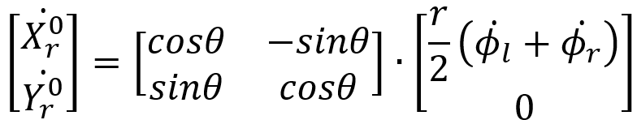
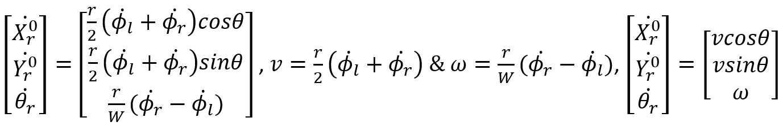
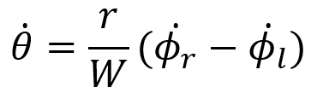
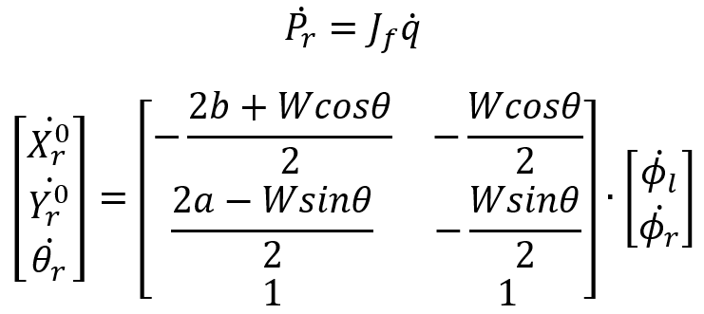
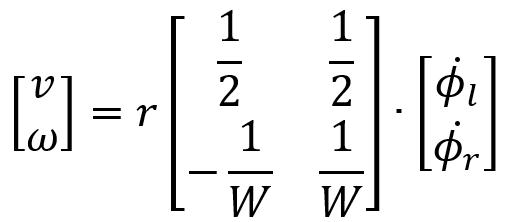

III. Mathematical Model
Problem Statement: Find $X_{rover}^{now}$ & $Y_{rover}^{now}$ given axle width W, wheel radius r, wheel motion history $\dot{φ_{r}} \& \dot{φ_{l}}$, and initial position $X_{rover}^{0}$ & $Y_{rover}^{0}$
c. Forward Kinematics
*Note: Due to system nature, velocity space work first, then integrate back to position
Rover Velocity World Frame from Wheel Velocity
To World Frame
Simplified
Jacobian

Slide 9
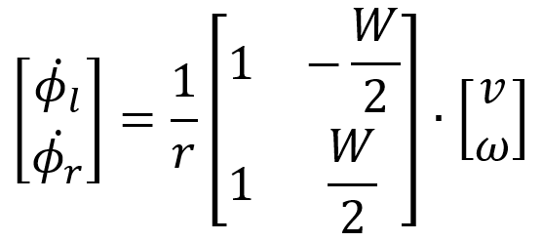
III. Mathematical Model
d. Inverse Kinematics
Problem Statement: Given $X_{rover}^{0}$ & $Y_{rover}^{0}$ & $θ$, find $\dot{φ_{r}} \& \dot{φ_{l}}$ (or $v \& ω$)
Infinitely many solutions to get to specified point!
Can rotate in place, then advance in straight line to goal , then rotate again in place to final orientation
A bit goofy looking but allows streamlined mathematics
If obstacles, path-planning becomes involved

Slide 10
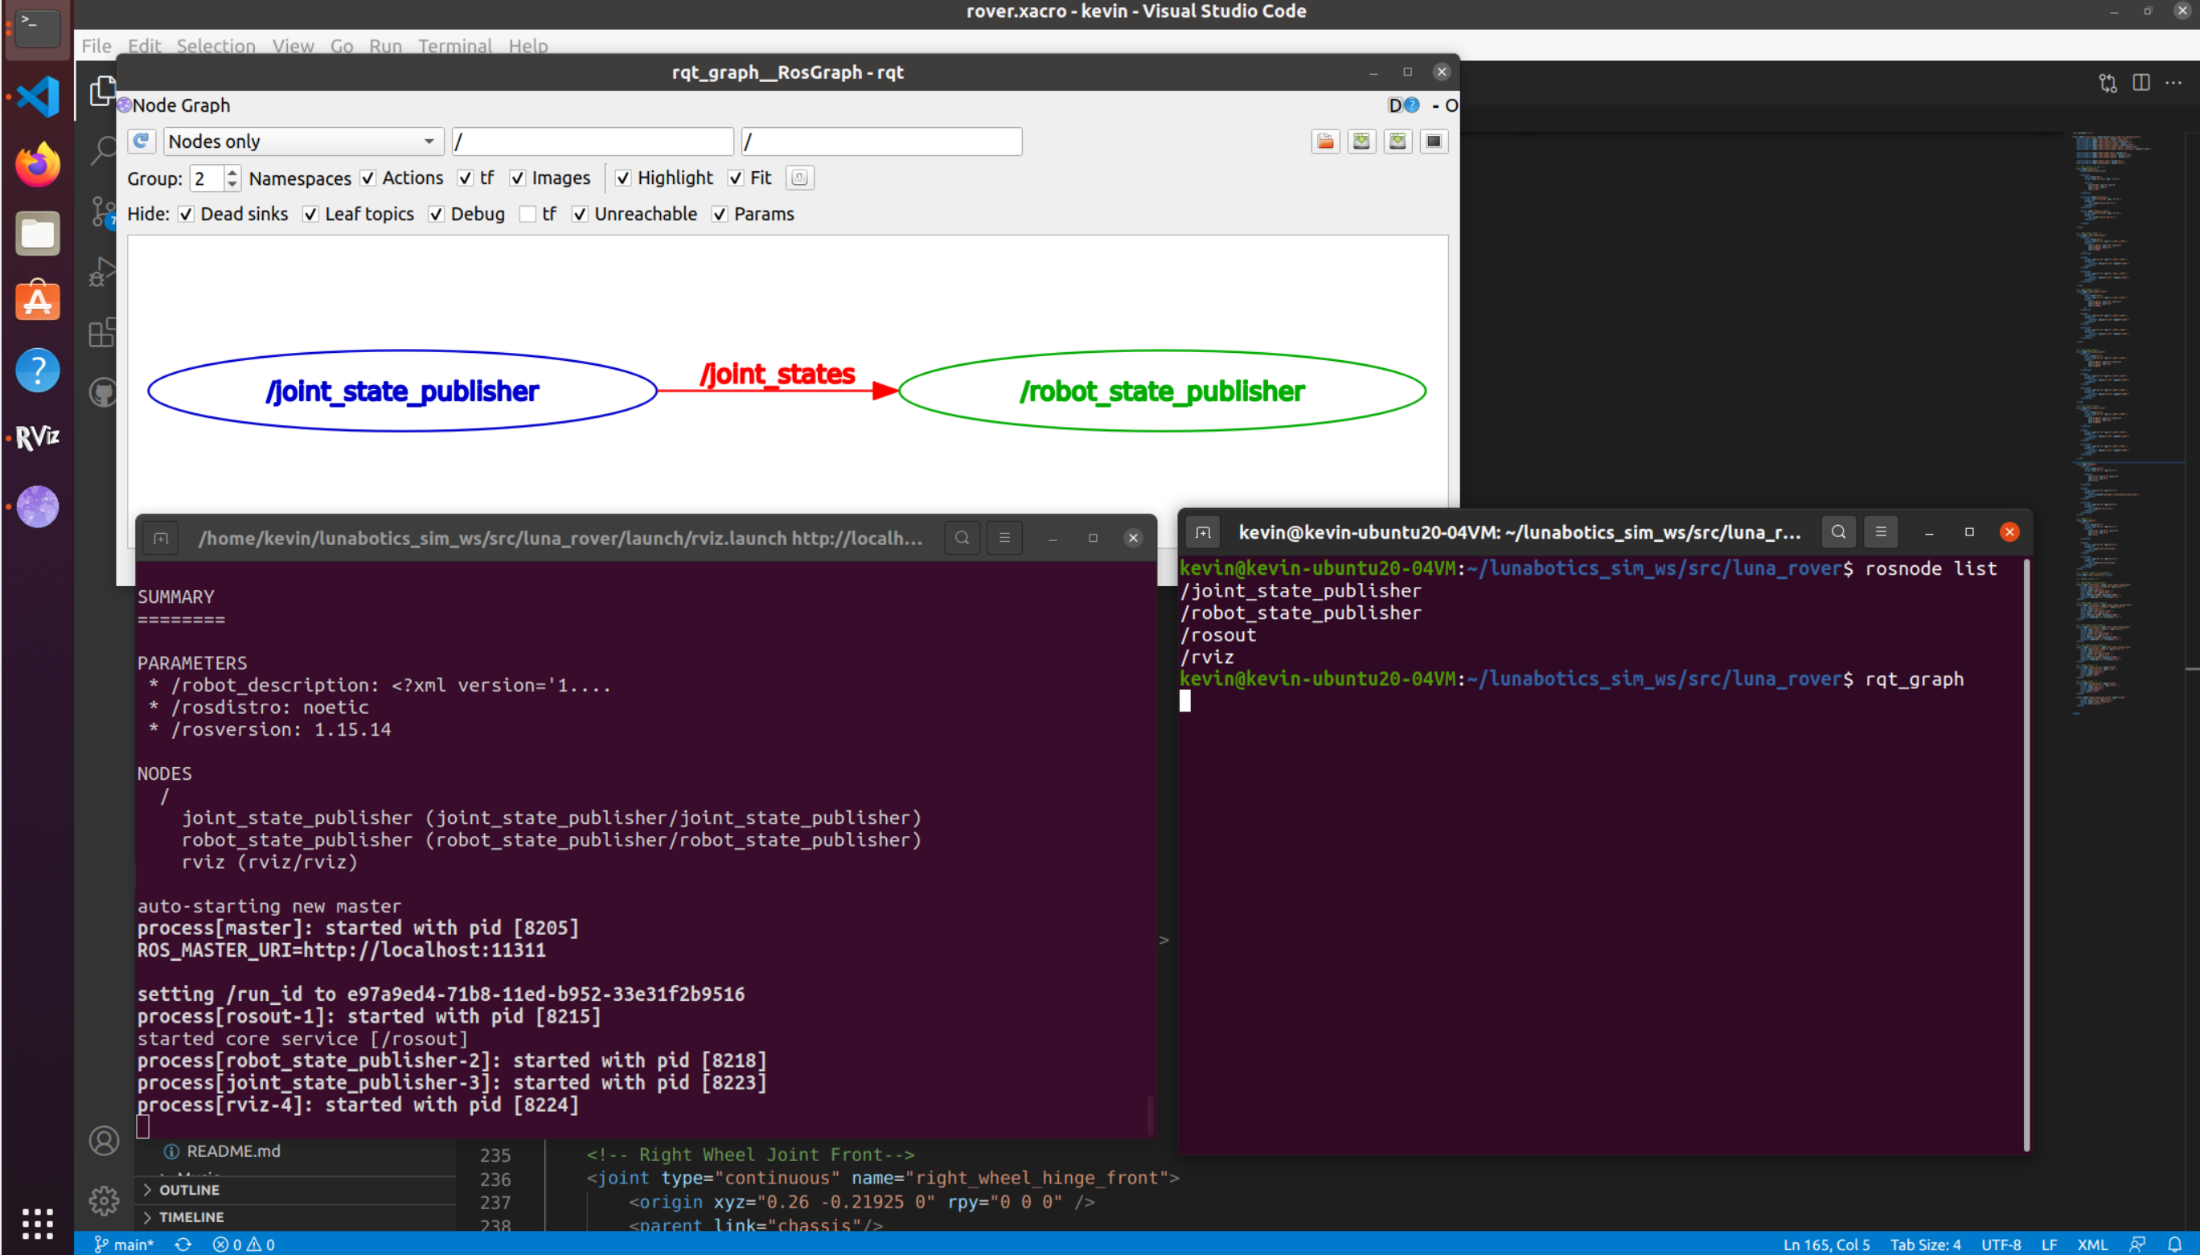
Graph showing message “publisher” and “subscriber” data flow for robot joint states
IV. Simulation
a. ROS
Middleware robot system framework
Graph / node-based message passing
Service & client “multithreading”
“compiled” using language agnostic catkin_make
List of running nodes
“Master” node and process controller

Slide 11
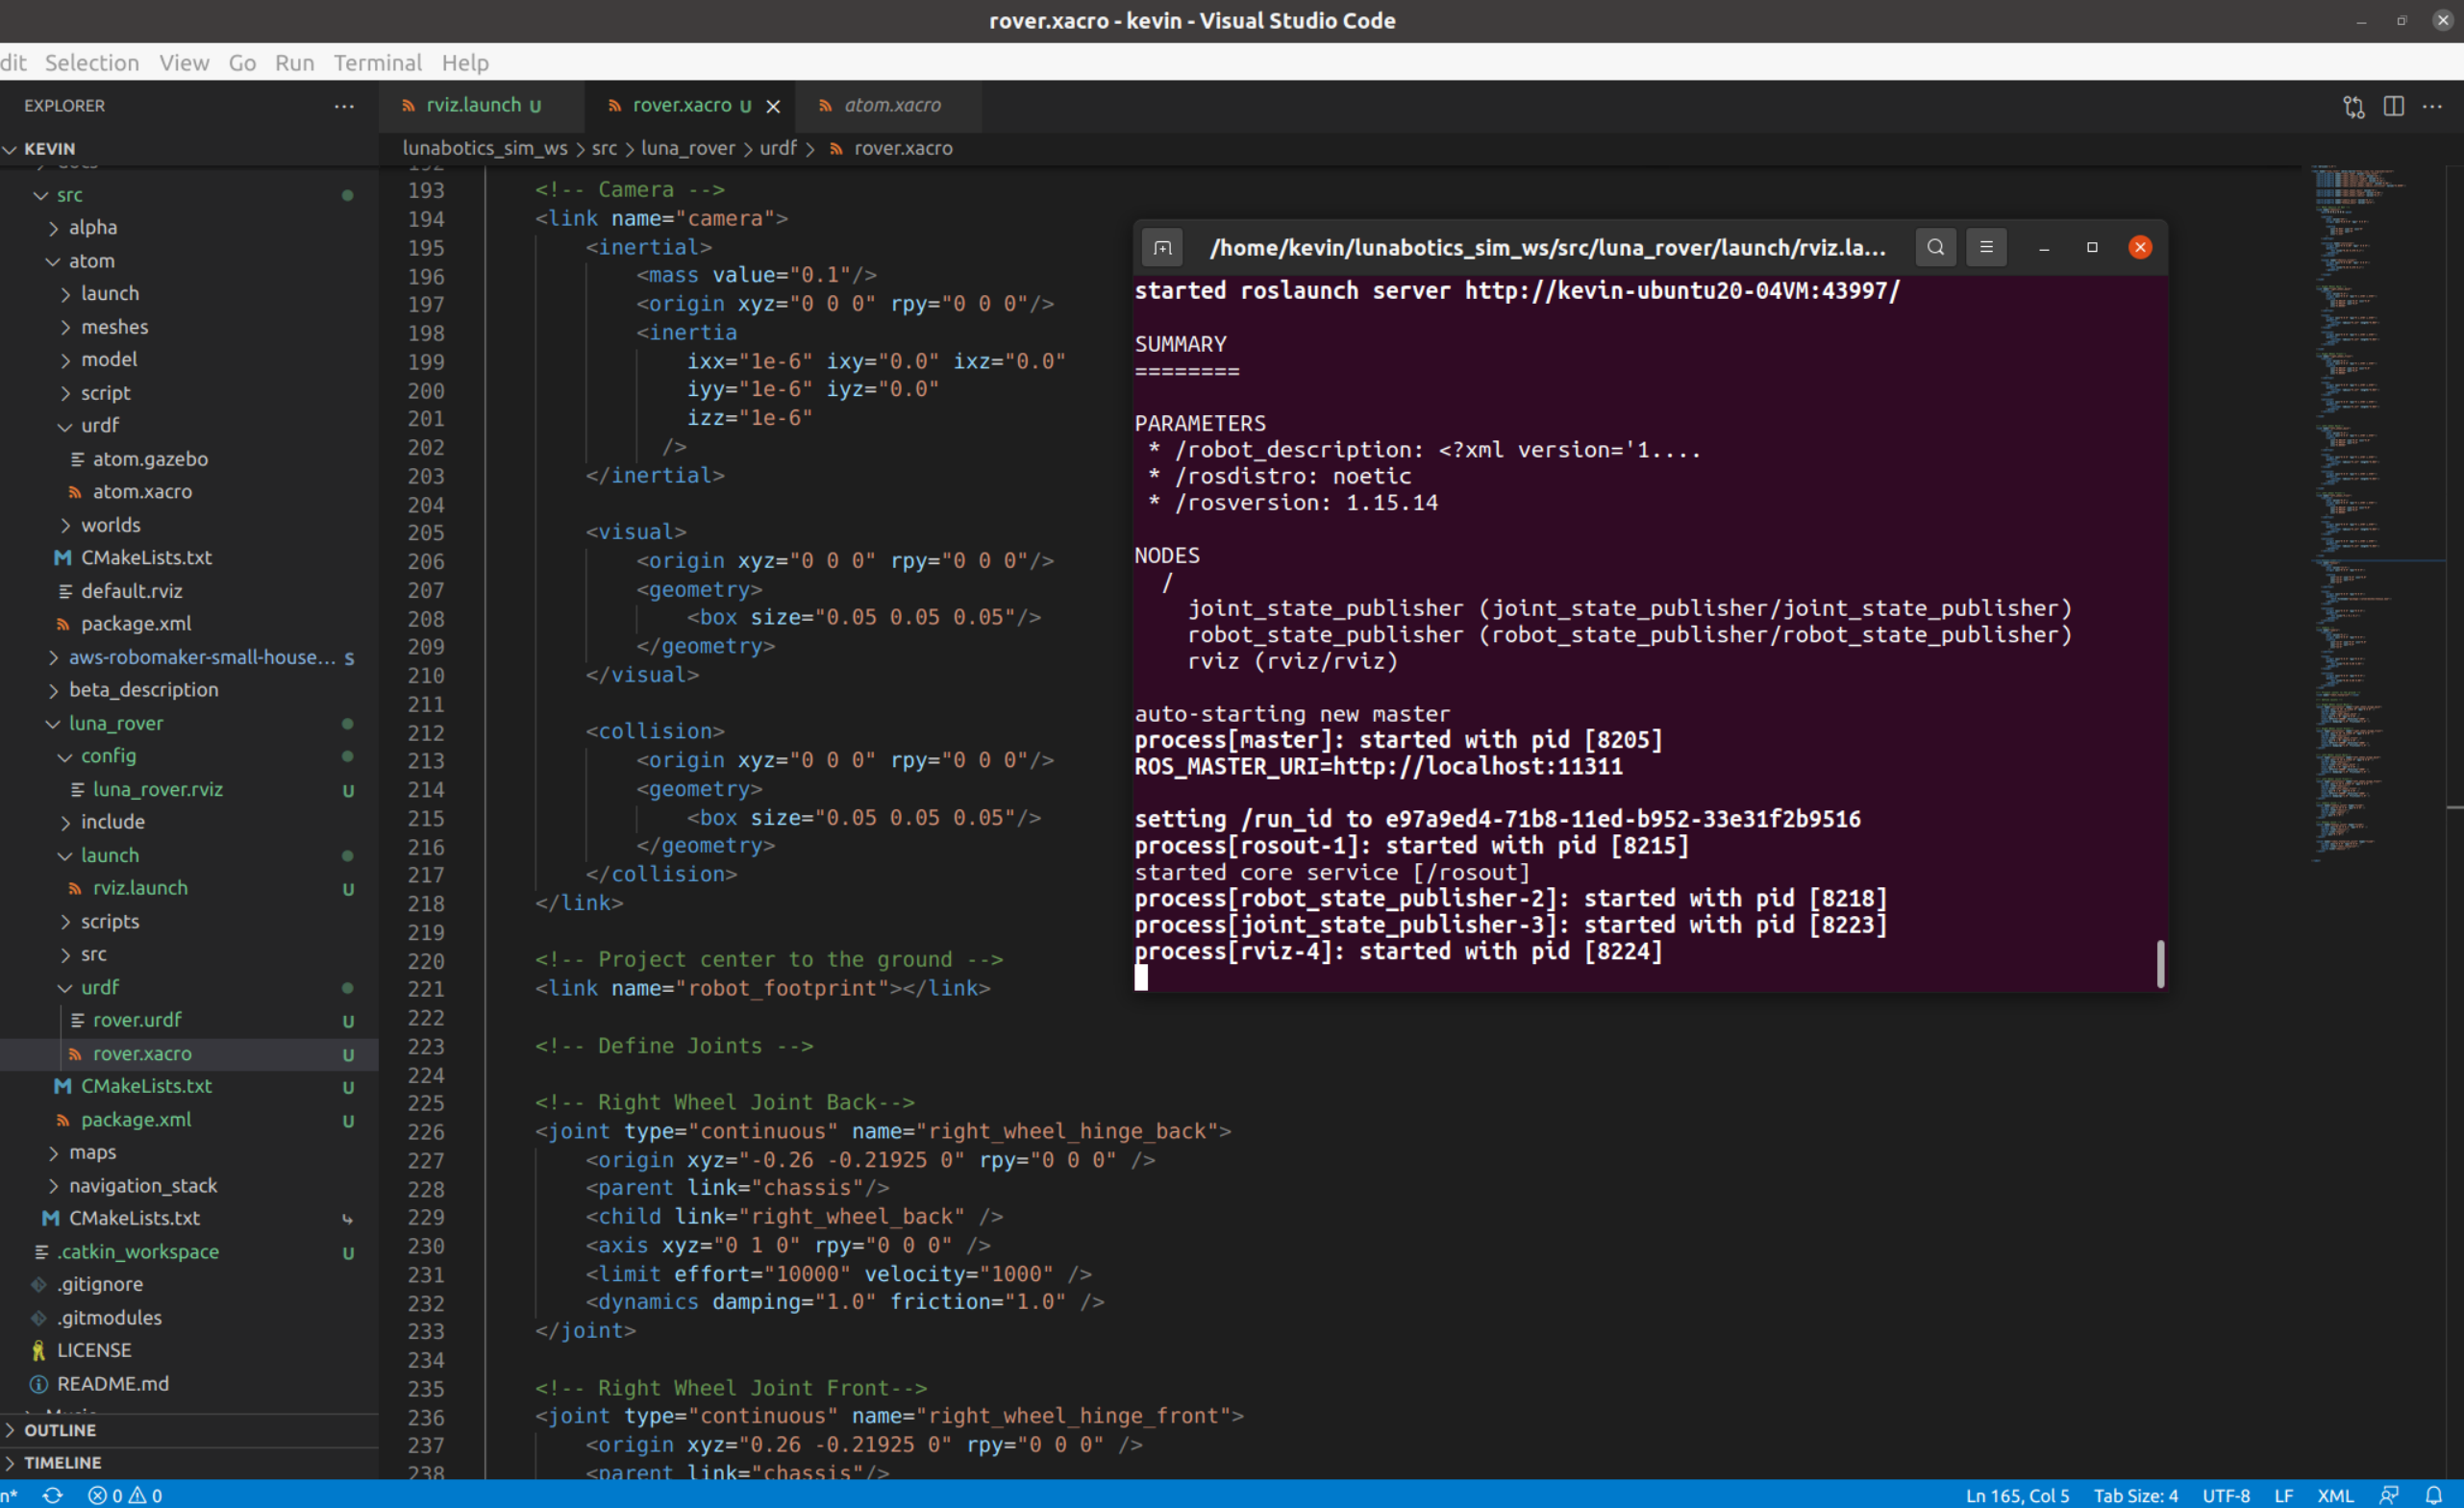
Unified Robot Description Format (.urdf)
Used to build joint-link model, define physics parameters, & sensor plugins
Launch files (.launch)
Used to start all needed environments and models
World files (.world or .sdf)
Specifies base world model objects & parameters
IV. Simulation
b. URDF & other needed filetypes
Configuration files (.config or .rviz)
Set parameters in simulation environments
Node files (.cpp or .py)
Robot functions source code
Build files (.xml & CMakeLists.txt)
Used to “compile” all other files into ROS executable
.xacro & .gazebo
Optional better description filetypes

Slide 12
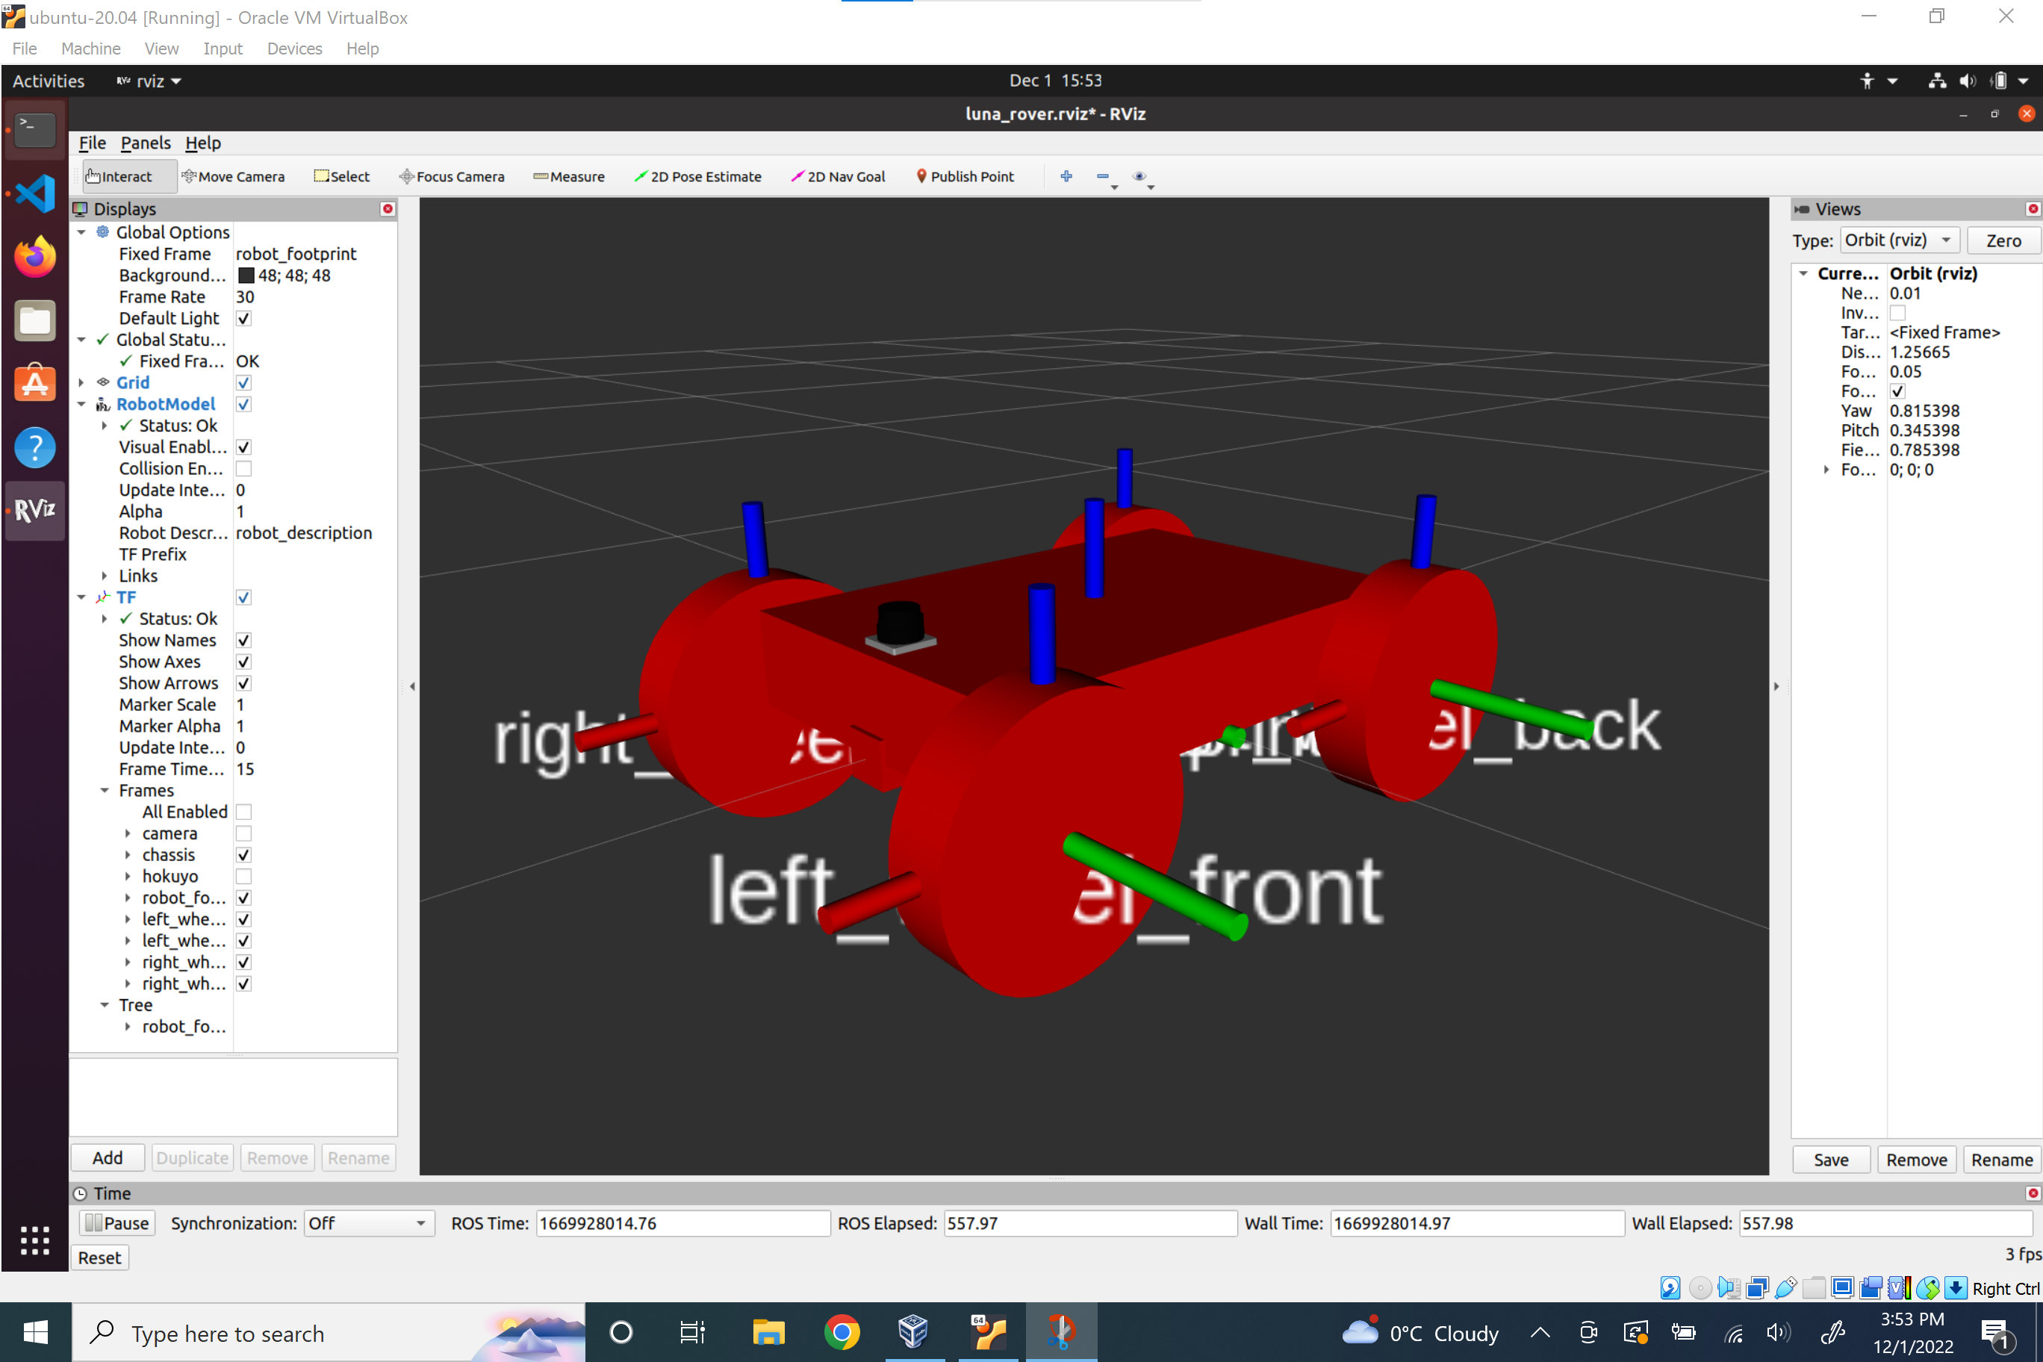
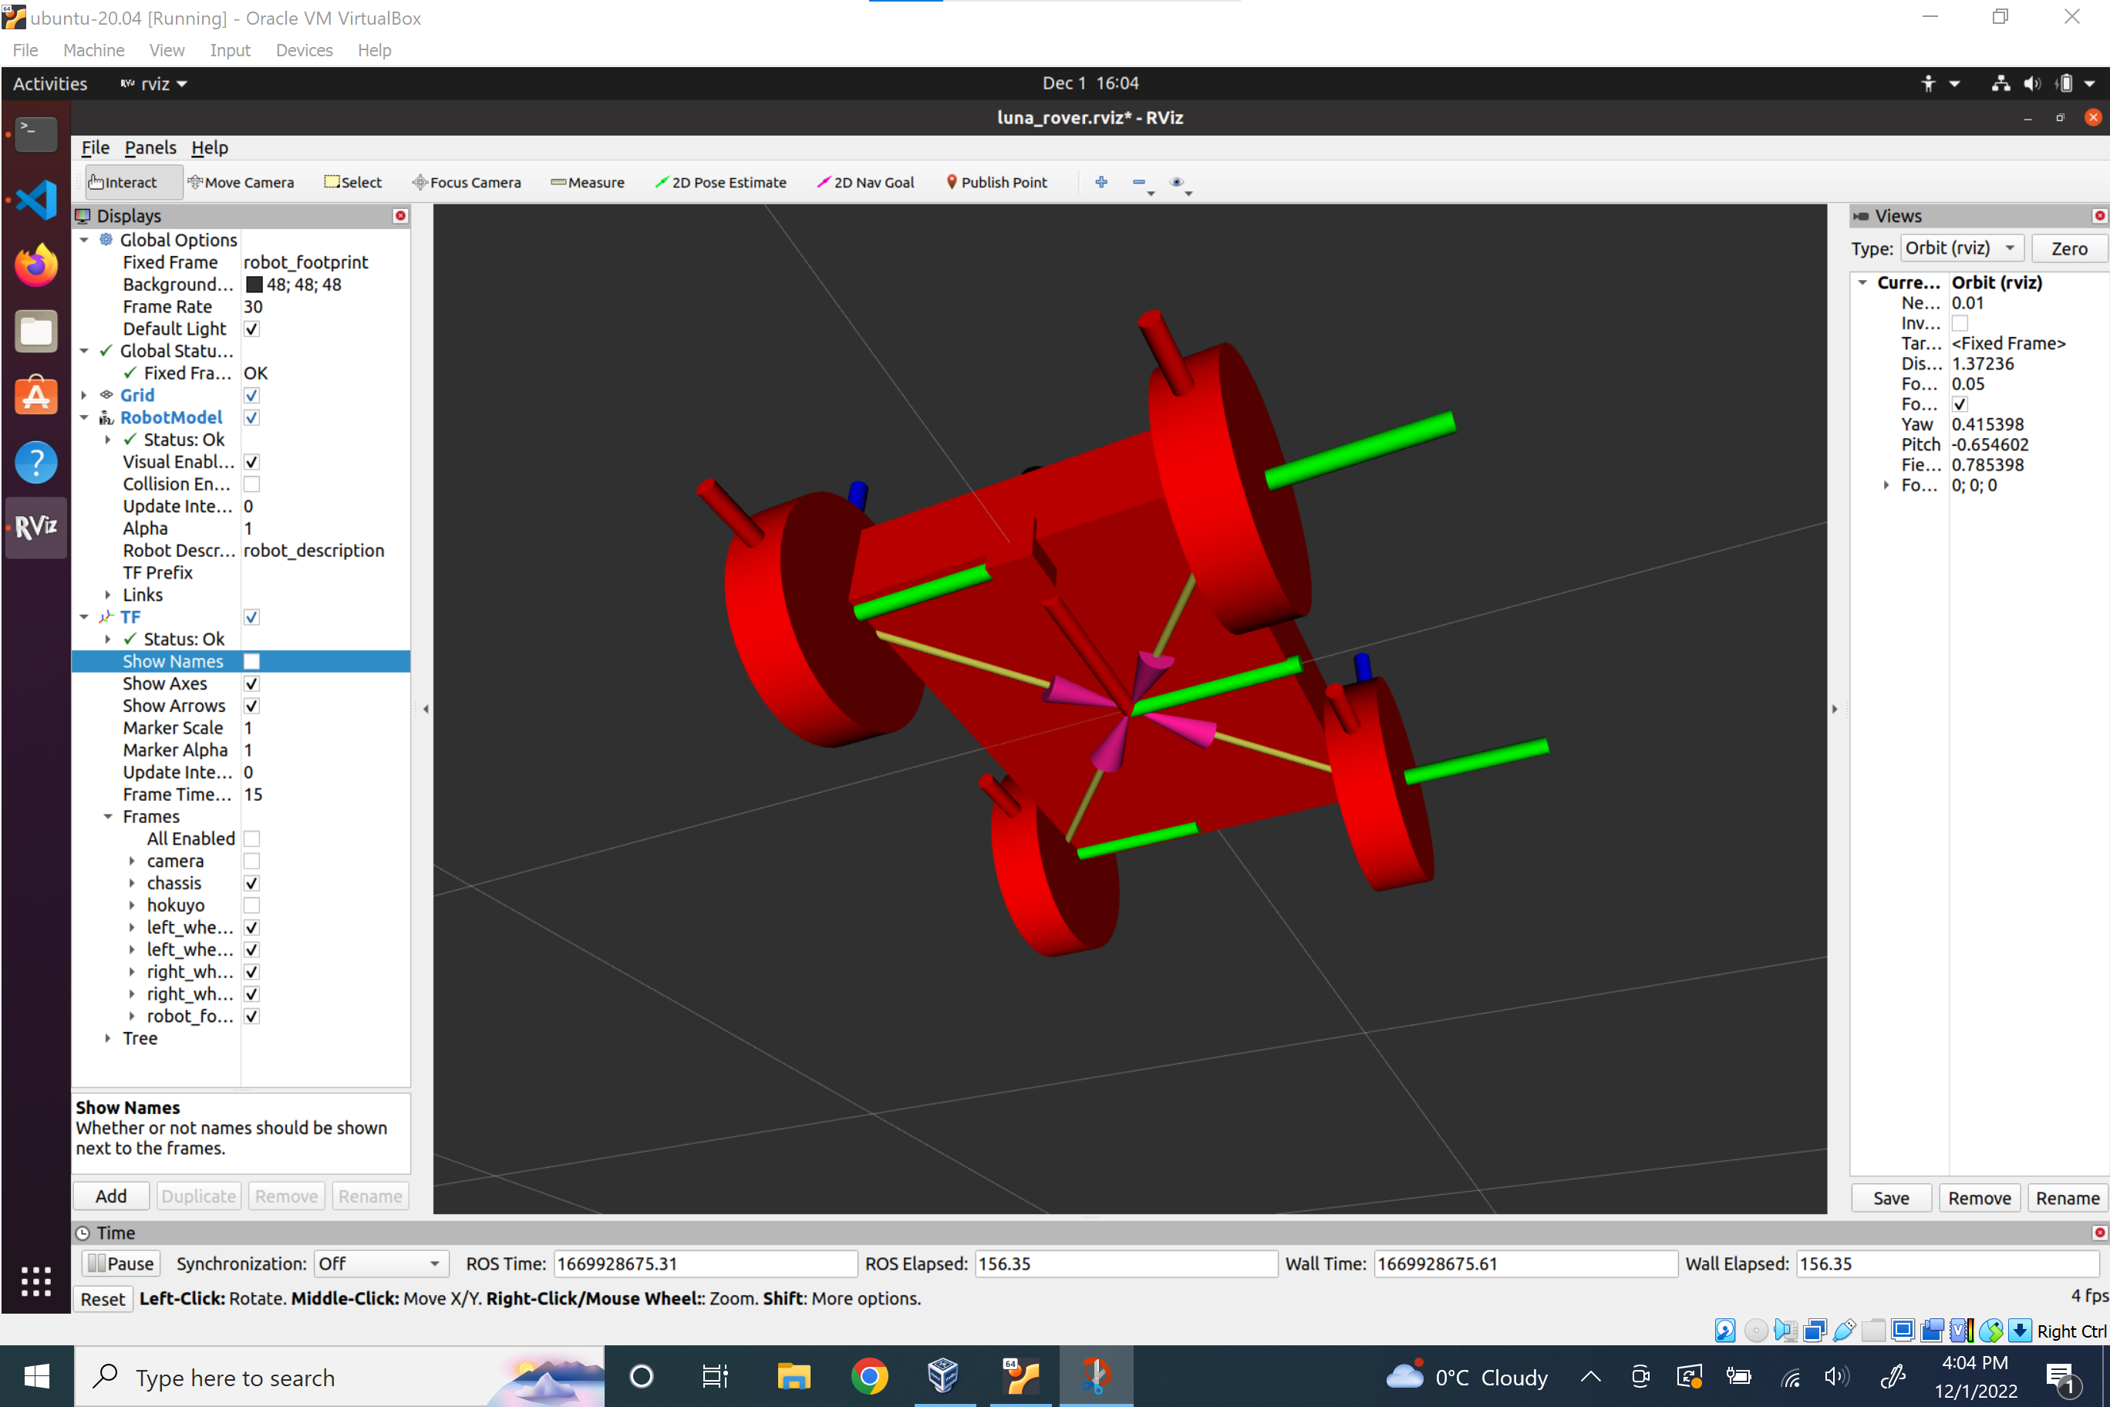
Top/Front view of rendered rover URDF with joint coordinate frame transforms and link names
IV. Simulation
c. rviz
3D visualization tool for ROS
Renders URDF and allows joint manipulation
Shows joint & link transforms
Receives sensor data from Gazebo simulation
Under view showing base link where transforms originate

Slide 13
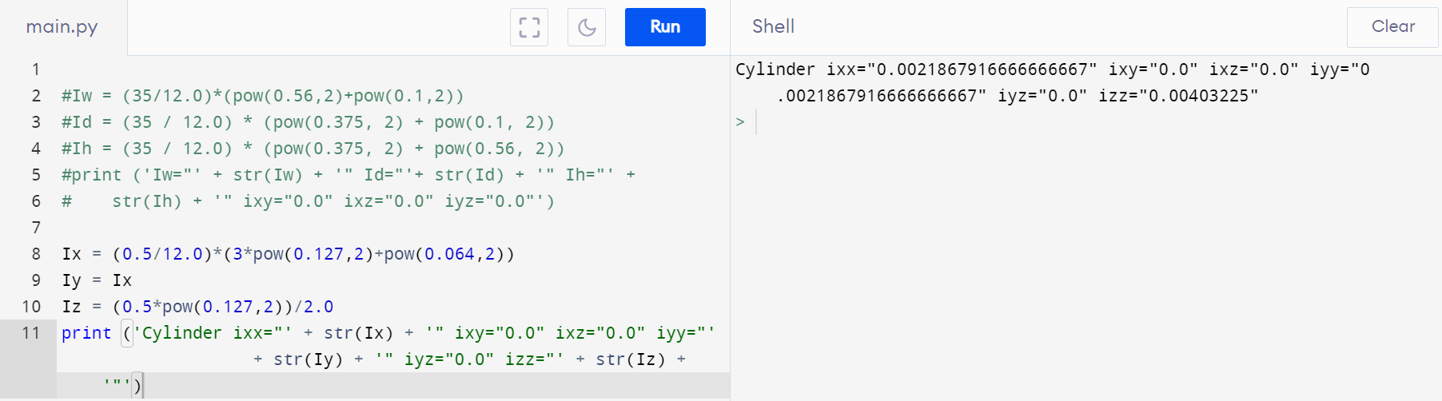
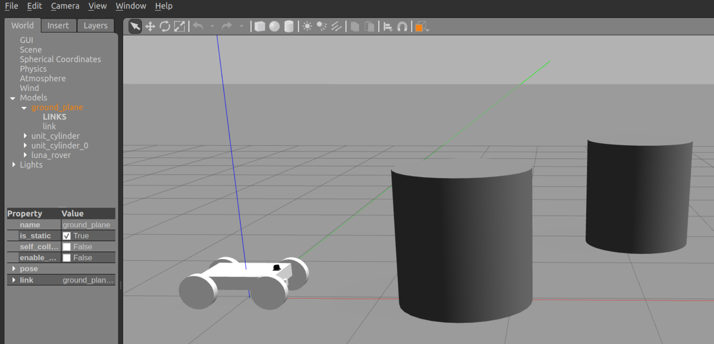
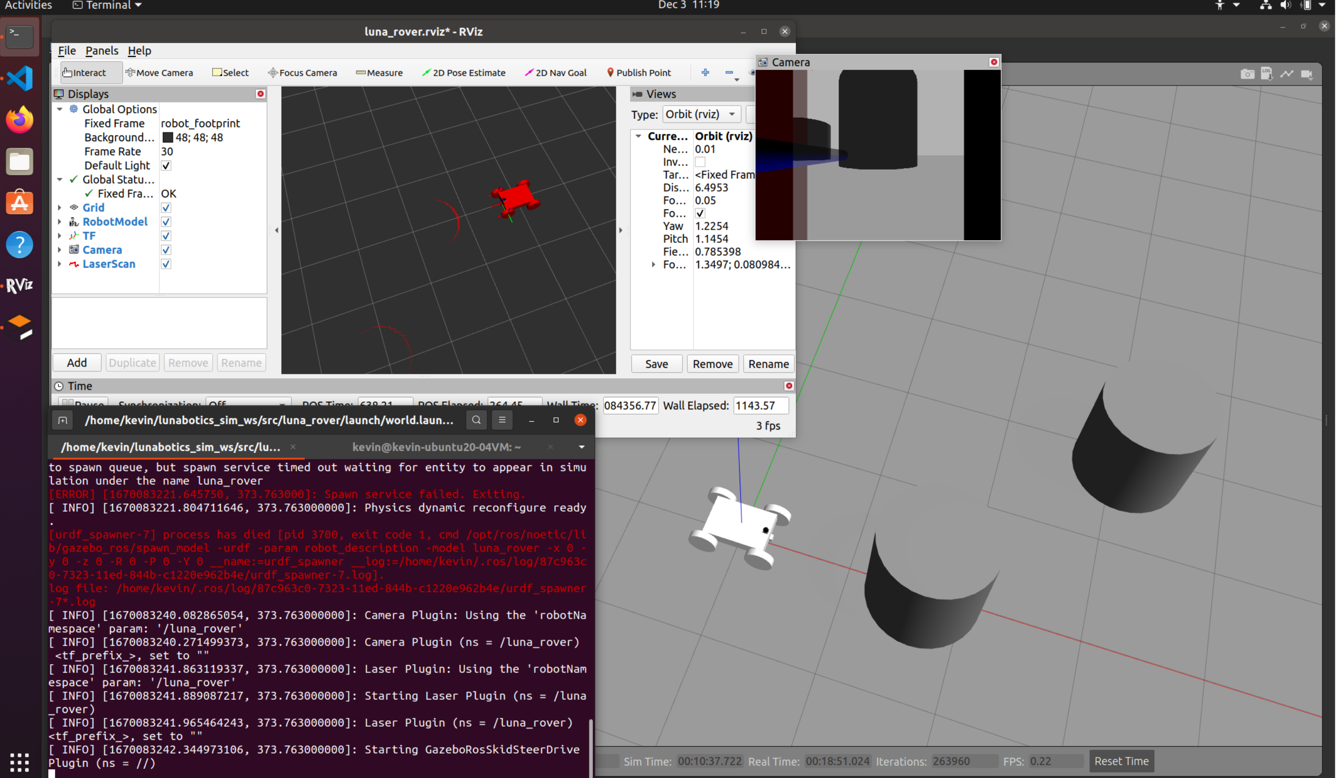
Gazebo only
IV. Simulation
Inertia Calcs
d. Gazebo
Physics Engine
Specific environment parameters
Inertia, collision, gravity, etc
Further specification of robot behavior in simulation environment
rviz
rviz camera view
rviz lidar
Gazebo
ROS control
terminal

Slide 14
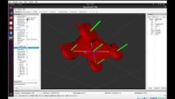
IV. Simulation
e. Demo

Slide 15
V. Rover Integration & Testing (Future Work)
Phase VI: Integration
Jan -> mid Feb
Normally wouldn’t be able to work on software
Simulation ready to go removes this roadblock
Incremental addition of algorithms / software blocks to ROS / rviz / Gazebo for testing
Phase V: Debugging
Further refining of autonomy algorithms
Hardware specific integration
Sensor tuning / calibration
Bringing simulated control code into real world target hardware
Review of how well simulated vs hardware results matched

Slide 16
VI. Conclusions
ROS is awesome!
Steep learning curve
Super powerful for real robotics!
New tools take time to learn
Maybe 1 at a time next time!
Probably don’t use a VM
Taxed 1 core of my lil’ dual-core m3 to the limit
More RAM please!
1 sim_time : ~40 real_time (s)
True simulation is incredibly complex
2D -> 3D is a huge step
3D ideal -> 3D with environmental variables such as inertia, friction, etc is also huge!
Kinematics, dynamics, & joint transform modelling theory really helps debug
Simulation environments for scalable systems come with many predefined structures
Datatypes, conventions, etc means theory adapts to software not other way around
New Software / Tools Learned:
ROS, rospy, roscpp, Gazebo, rviz, xacro, SDF, URDF, XML, CMakeLists, VirtualBox, Docker, & more!

Slide 17
VII. References
[1] A. K. El-Shenawy and T. El-Derini, “Solving the singularity of car like robot with back trailer,” 2012 22nd International Conference on Computer Theory and Applications (ICCTA), pp. 105–110, Oct. 2012.
[2] “differentialDriveKinematics,” Differential-drive vehicle model - MATLAB. [Online]. Available: https://www.mathworks.com/help/robotics/ref/differentialdrivekinematics.html#d124e8792. [Accessed: 01-Dec-2022].
[3] F. Dellaert and S. Hutchinson, “Introduction to robotics and perception,” 5.2. Motion Model for the Differential Drive Robot - Introduction to Robotics and Perception, 2021. [Online]. Available: https://www.roboticsbook.org/S52_diffdrive_actions.html. [Accessed: 29-Oct-2022].
[4] H. Mittal, “Harshmittal2210/robotics_ws: Robotics workspace - for different ROS projects,” GitHub. [Online]. Available: https://github.com/harshmittal2210/Robotics_ws. [Accessed: 17-Nov-2022].
[5] H. Mittal, “Learn ros basics by creating a custom 4 wheeled robot with Camera & LIDAR | Gazebo | URDF | Xacro,” YouTube, 27-Dec-2021. [Online]. Available: https://www.youtube.com/watch?v=mDHActlZi50. [Accessed: 17-Nov-2022].
[6] K. Woeltje, “Inertia calculator,” The Construct ROS Community, 03-Jan-2021. [Online]. Available: https://get-help.robotigniteacademy.com/t/inertia-calculator/7295. [Accessed: 28-Nov-2022].
[7] M. Luqman, “Muhammad Luqman's YouTube Channel,” YouTube. [Online]. Available: https://www.youtube.com/@robotisim/videos. [Accessed: 28-Nov-2022].
[8] M. Luqman, “NOSHLUK2/ros1_wiki: This repository contains video demonstration and explanation for ros1 wiki pages,” GitHub. [Online]. Available: https://github.com/noshluk2/ros1_wiki. [Accessed: 22-Nov-2022].
[9] M. Vona, “CS4610/CS5335: L3 - Differential Drive Kinematics,” CS4610/CS5335: L3 - differential drive kinematics. [Online]. Available: https://course.ccs.neu.edu/cs4610/L3/L3.html. [Accessed: 13-Oct-2022].
[10] “Mobile Robot Kinematics - United States Naval Academy.” [Online]. Available: https://www.usna.edu/Users/cs/crabbe/SI475/current/mob-kin/mobkin.pdf. [Accessed: 08-Nov-2022].
[11] Osrf, “Gazebo tutorials,” gazebo. [Online]. Available: https://classic.gazebosim.org/tutorials. [Accessed: 16-Oct-2022].
[12] P. Bhounsule, “Robotics lec7: Inverse kinematics of differential drive car (fall 2020),” YouTube, 09-Sep-2020. [Online]. Available: https://www.youtube.com/watch?v=6oor2CnSx8M&list=PLc7bpbeTIk741sSBpPzj5hl_L8Wlrn1u8&index=11. [Accessed: 12-Nov-2022].
[13] P. Muir. “Modeling and control of wheeled mobile robots,” PhD dissertation Carnegie Mellon University (1987).
[14] “Ros developers live-class #14: How to control robot joints with ROS,” YouTube, 11-Apr-2018. [Online]. Available: https://www.youtube.com/watch?v=M4KF2c3OMSI&list=PLK0b4e05LnzbuxWCdip-2Tf-SIiZle5NA&index=150. [Accessed: 12-Nov-2022].
[15] “ROS Tutorials,” ros.org. [Online]. Available: http://wiki.ros.org/ROS/Tutorials. [Accessed: 10-Oct-2022].
[16] T. M. N. El-Derini, “Individual actuators of a car-like robot with back trailer,” International Journal of Electrical, Computer, Energetic, and Communications Engineering, vol. 8, no. 12, pp. 1842–1847, 2014.

Slide 18
Questions…
???

